Slide 1
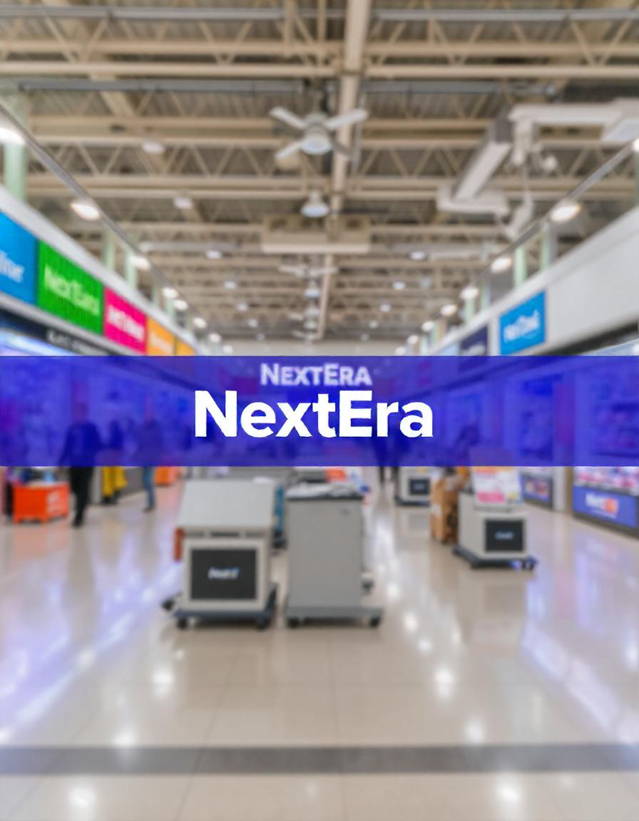

NextEra
Supplies
Menu
About Us
@NextEraSuppliesSite
revolutionizing online shopping
Exploring Business Insights and Forecasting Future Sales
www.NextEraSupplies.com

Slide 2


NextEra
Supplies
Menu
About Us
@NextEraSuppliesSite
content
About Us
Vision and Mission
Data Journey
Business Insights
Predictive Modeling
Results & Conclusions

Slide 3
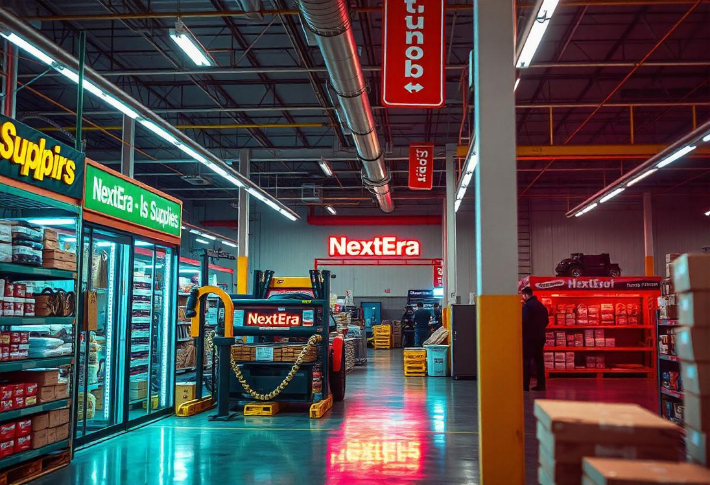

NextEra
Supplies
Menu
About Us
@NextEraSuppliesSite
rapidly grown into a leading eCommerce platform
Founded in 2008, NextEra Supplies has rapidly become a global leader in providing advanced technology solutions for businesses and individuals. From cutting-edge electronics and smart office equipment to innovative software tools, we offer a comprehensive range of products designed to meet the demands of a dynamic and competitive market. By leveraging the latest advancements in technology and a deep understanding of customer needs, we ensure a seamless and efficient shopping experience for clients worldwide.
We are committed to empowering businesses and fostering long-term relationships by delivering exceptional value and support. Our platform offers advanced analytics, intelligent tools, and customized solutions that help businesses streamline operations and drive growth. At NextEra Supplies, every product we offer and every service we provide is an opportunity to create meaningful connections and shape a future where technology empowers progress.
a deep understanding of consumer behavior

Slide 4

NextEra
Supplies
@NextEraSuppliesSite
Menu
About Us
vision
To be the most customer-centric and innovative retailer & eCommerce platform globally, offering unparalleled convenience, personalized experiences, and empowering businesses of all sizes to thrive in the digital marketplace.
mision
Customer Focus: To provide a seamless and enjoyable online shopping experience by offering a vast selection of quality products and top-notch customer service.
Innovation: To continuously innovate and integrate cutting-edge technologies that enhance the shopping experience and streamline operations for sellers.

Slide 5

NextEra
Supplies
Menu
About Us
@NextEraSuppliesSite
Market Overview Opportunity
The global retail & eCommerce market has witnessed exponential growth in recent years, driven by increasing internet penetration, the rise of mobile shopping, and changing consumer behaviors. The market is projected to continue expanding, presenting significant opportunities for businesses that adapt to these trends. Key factors contributing to the market opportunity include:

Slide 6
NextEra
Supplies
Menu
About Us
@reallygreatsite
1. Millennials and Gen Z
Demographics: Aged 18-35, tech-savvy, and socially conscious.
Behavior: Prefers online shopping, values convenience and personalization, and is influenced by social media and online reviews.
target
audience
2. Busy Professionals
Demographics: Aged 25-45, working full-time, and often juggling multiple responsibilities.
Behavior: Seeks convenience and time-saving solutions, often shopping online during breaks or commutes.
To effectively harness the market opportunity, we have identified our target audience as follows:
3. Families and Parents
Demographics: Aged 30-50, often with children, seeking products for family needs.
Behavior: Values quality and affordability, often purchasing in bulk or seeking deals.

Slide 7

NextEra
Supplies
Menu
About Us
@reallygreatsite
growth strategy
At NextEra Supplies, our growth strategy is built to harness the transformative power of technology while ensuring sustainable and scalable development. Key components of our growth strategy include:
Enhancing User Experience
Expanding Product Range
Utilizing Data Analytics

Slide 8
NextEra
Supplies
Menu
About Us
@NextEraSuppliesSite
future goals
Looking ahead, NextEra Supplies aims to achieve the following goals over the next three to five years:
Revenue Growth
Customer Base
Market Penetration
Technology
Achieve a 97% increase in annual revenue year-over-year through expanded market share and product offerings.
Increase our active customer base by 400% by enhancing our marketing outreach and improving customer retention rates.
Enter 30 new international markets, establishing a presence in regions with significant eCommerce growth potential.
Implement advanced technologies such as AI, machine learning, and augmented reality to enhance shopping experiences and streamline operations.

Slide 9



NextEra
Supplies
Menu
About Us
@NextEraSuppliesSite
thank you
123 Anywhere St.
+123-456-7890
@NextEraSupplie.co

